Slide 1

SCS1301 - OPERATING SYSTEM
UNIT – 4
STORAGE / MEMORY MANAGEMENT
Ms. B KEERTHI SAMHITHA
ASSISTANT PROFESSOR
DEPARTMENT OF CSE
SCHOOL OF COMPUTING

Slide 2
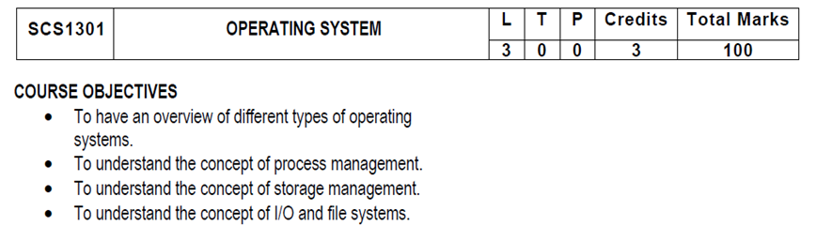
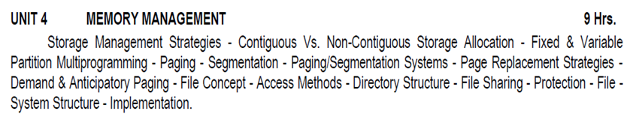
SYLLUBUS

Slide 3
COURSE OUTCOMES
SCS1301.1 | Comprehend knowledge about Operating system components and services.
SCS1301.2 | Apply knowledge of process scheduling algorithms for a given context.
SCS1301.3 | Analyze process synchronization and deadlock conditions.
SCS1301.4 | Construct the process of Mapping logical address to physical address.
SCS1301.5 | Design appropriate strategies for Paging, Segmentation.
SCS1301.6 | Develop real time applications Based on Linux shell programming.

Slide 4
STORAGE / MEMORY MANAGEMENT
Memory management is the functionality of an operating system which handles or manages primary memory.
Memory management keeps track of each and every memory location either it is allocated to some process or it is free.
It checks how much memory is to be allocated to processes.
It decides which process will get memory at what time.
It tracks whenever some memory gets free or unallocated and correspondingly it updates the status.

Slide 5
GOALS OF MEMORY MANAGEMENT
Allocate available memory efficiently to multiple processes
Main functions
Allocate memory to processes when needed
Keep track of what memory is used and what is free
Protect one process’s memory from another

Slide 6
What is Memory Management?
Memory Management is the process of controlling and coordinating computer memory, assigning portions known as blocks to various running programs to optimize the overall performance of the system.
It is the most important function of an operating system that manages primary memory.
It helps processes to move back and forward between the main memory and execution disk.
It helps OS to keep track of every memory location, irrespective of whether it is allocated to some process or it remains free.

Slide 7
Why Use Memory Management?
It allows you to check how much memory needs to be allocated to processes that decide which processor should get memory at what time.
Tracks whenever inventory gets freed or unallocated. According to it will update the status.
It allocates the space to application routines.
It also make sure that these applications do not interfere with each other.
Helps protect different processes from each other
It places the programs in memory so that memory is utilized to its full extent.

Slide 8
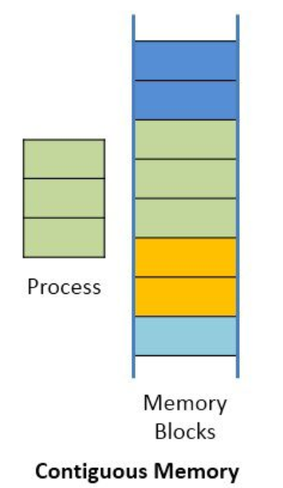
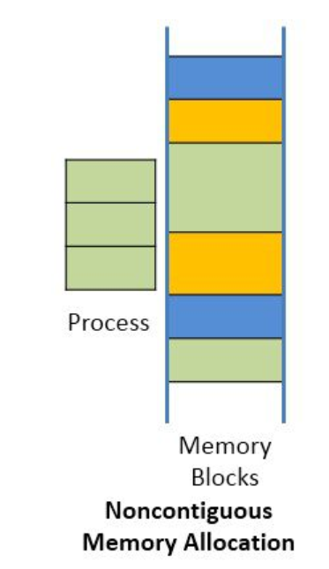
MEMORY ALLOCATION STRATEGIES
CONTIGUOUS ALLOCATION NON-CONTIGUOUS ALLOCATION

Slide 9
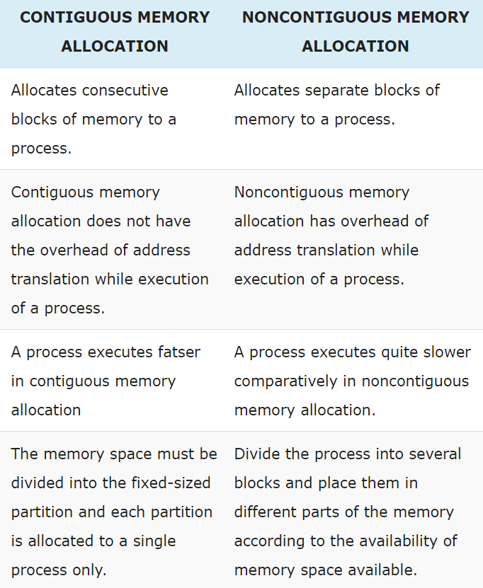

Slide 10
CONTIGUOUS ALLOCATION
In contiguous memory allocation each process is contained in a single contiguous block of memory.
Memory is divided into several fixed size partitions.
Each partition contains exactly one process.
When a partition is free, a process is selected from the input queue and loaded into it.
The free blocks of memory are known as holes.
The set of holes is searched to determine which hole is best to allocate

Slide 11
NON-CONTIGUOUS ALLOCATION
Parts of a process can be allocated noncontiguous chunks of memory.
In context to memory organization, non contiguous memory allocation means the available memory space is scattered here and there it means all the free available memory space is not together at one place.

Slide 12
What is Memory Partitioning in OS?
Utilization of memory and flow of execution, we divide the memory into different sections to be used by the resident programs.
The process of dividing the memory into sections is called memory partitioning.
There are different ways in which memory can be partitioned:
FIXED PARTITION SCHEME
VARIABLE PARTITION SCHEME

Slide 13
FIXED PARTITION SCHEME
In fixed partitioning, the number of non-overlapping partitions in RAM is fixed, but the size of each partition may not be the same.
As the allocation of memory is contiguous, no spanning is allowed.
In fixed partitioning, the partitions are made either before execution or during system configuration.

Slide 14
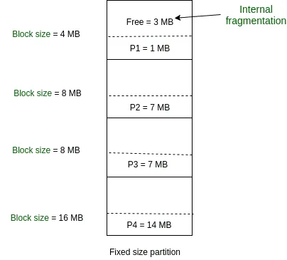

Slide 15
VARIABLE PARTITION SCHEME
Hole – block of available memory; holes of various size are scattered throughout memory
When a process arrives, it is allocated memory from a hole large enough to accommodate it
Operating system maintains information about:
allocated partitions
free partitions (hole)

Slide 16
MULTIPROGRAMMING
To overcome the problem of underutilization of CPU and main memory, the multiprogramming was introduced.
The multiprogramming is interleaved execution of multiple jobs by the same computer.
In multiprogramming system, when one program is waiting for I/O transfer, there is another program ready to utilize the CPU.
SO it is possible for several jobs to share the time of the CPU.
But it is important to note that multiprogramming is not defined to be the execution of jobs at the same instance of time.

Slide 17
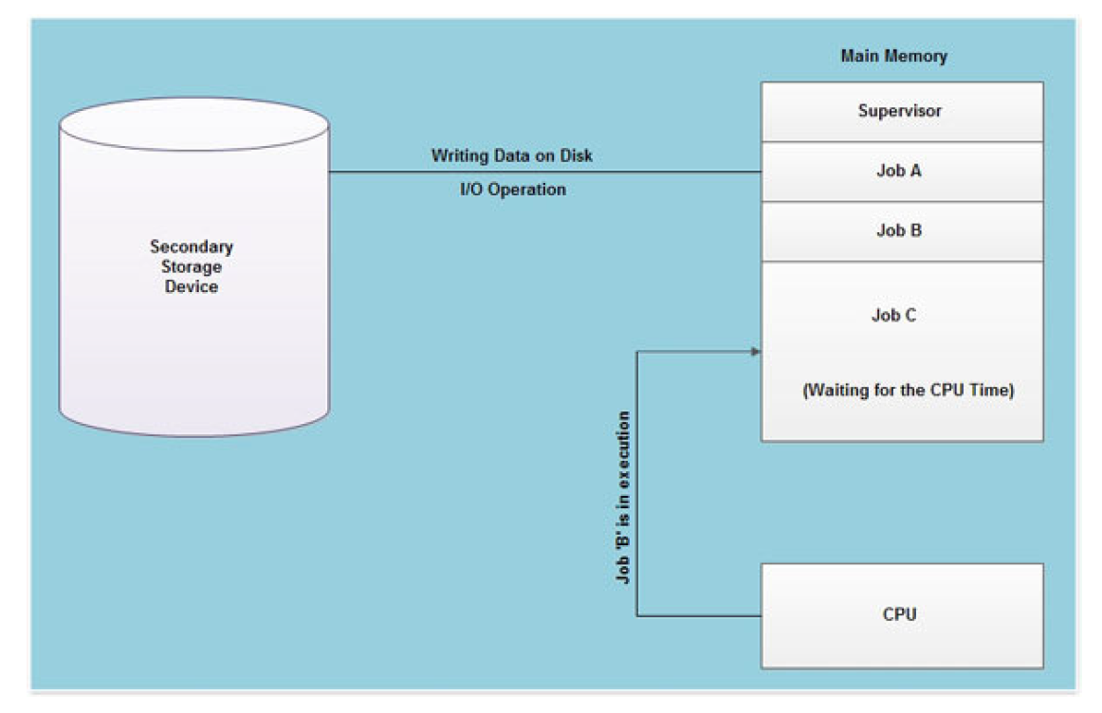

Slide 18
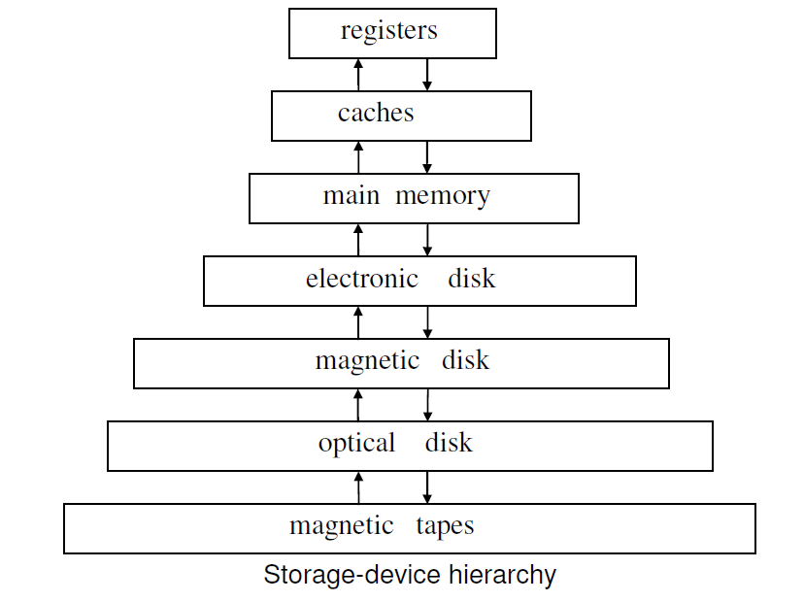
STORAGE HIERARCHY

Slide 19
STORAGE HIERARCHY
The wide variety of storage systems in a computer system can be organized in a hierarchy according to their speed and their cost.
The higher levels are expensive but fast. As we move down the hierarchy, the cost per bit decreases, whereas the access time increases.
The reason for using the slower memory decives is that they are cheaper than the faster ones.

Slide 20
What is Dynamic Loading?
Dynamic loading is a routine of a program which is not loaded until the program calls it.
All routines should be contained on disk in a relocatable load format.
The main program will be loaded into memory and will be executed.
Dynamic loading also provides better memory space utilization.

Slide 21
What is Dynamic Linking?
Linking is a method that helps OS to collect and merge various modules of code and data into a single executable file.
The file can be loaded into memory and executed.
OS can link system-level libraries into a program that combines the libraries at load time.
In Dynamic linking method, libraries are linked at execution time, so program code size can remain small.

Slide 22
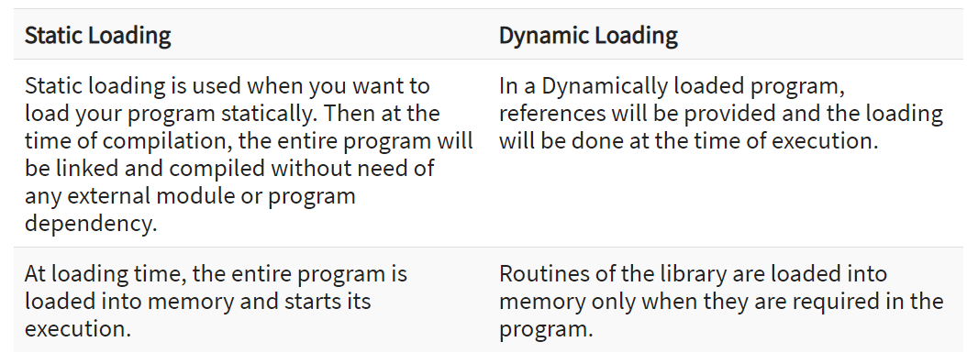
Static and Dynamic Loading

Slide 23
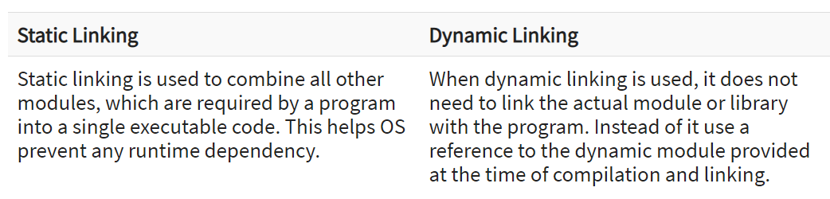
Static and Dynamic Linking

Slide 24
SWAPPING
Swapping is a method in which the process should be swapped temporarily from the main memory to the backing store.
It will be later brought back into the memory for continue execution.
Major time consuming part of swapping is transfer time.
Total transfer time is directly proportional to the amount of memory swapped.

Slide 25
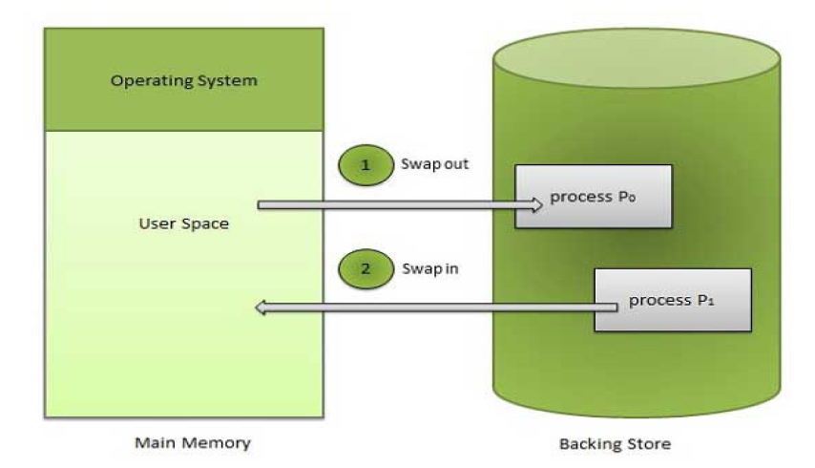

Slide 26
BENEFITS OF SWAPPING
It offers a higher degree of multiprogramming.
Allows dynamic relocation. For example, if address binding at execution time is being used, then processes can be swap in different locations. Else in case of compile and load time bindings, processes should be moved to the same location.
It helps to get better utilization of memory.
Minimum wastage of CPU time on completion so it can easily be applied to a priority-based scheduling method to improve its performance.

Slide 27
What is Memory allocation?
Memory allocation is a process by which computer programs are assigned memory or space.
Here, main memory is divided into two types of partitions
Low Memory - Operating system resides in this type of memory.
High Memory - User processes are held in high memory.

Slide 28
Partition Allocation
Memory is divided into different blocks or partitions.
Each process is allocated according to the requirement.
Partition allocation is an ideal method to avoid internal fragmentation

Slide 29
PARTITION ALLOCATION
Below are the various partition allocation schemes :
First Fit: In this type fit, the partition is allocated, which is the first sufficient block from the beginning of the main memory.
Best Fit: It allocates the process to the partition that is the first smallest partition among the free partitions.
Worst Fit: It allocates the process to the partition, which is the largest sufficient freely available partition in the main memory.
Next Fit: It is mostly similar to the first Fit, but this Fit, searches for the first sufficient partition from the last allocation point.

Slide 30
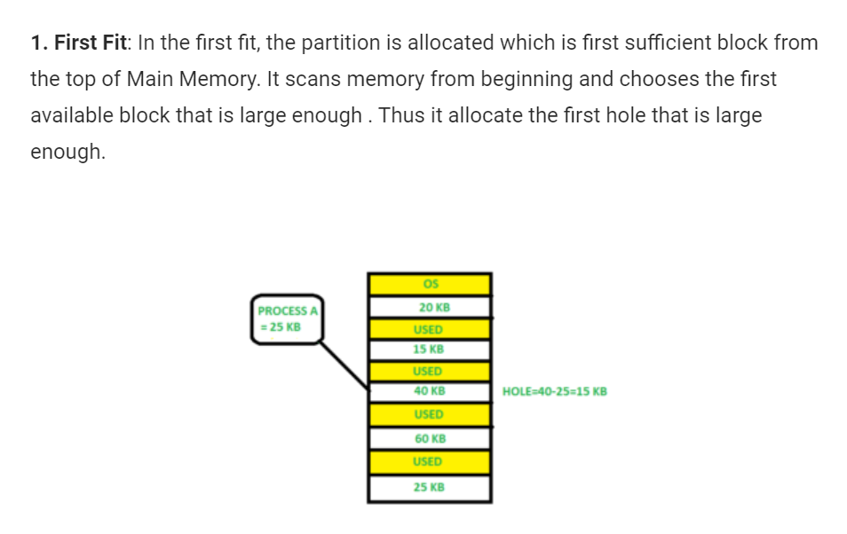

Slide 31
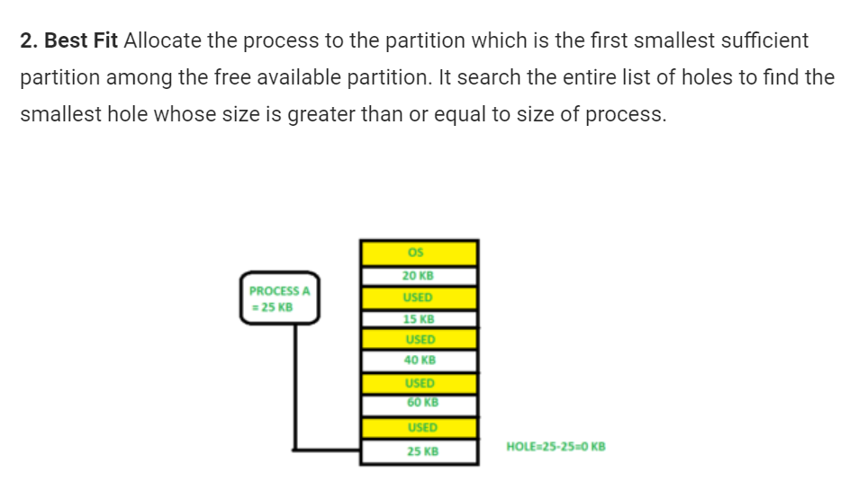

Slide 32
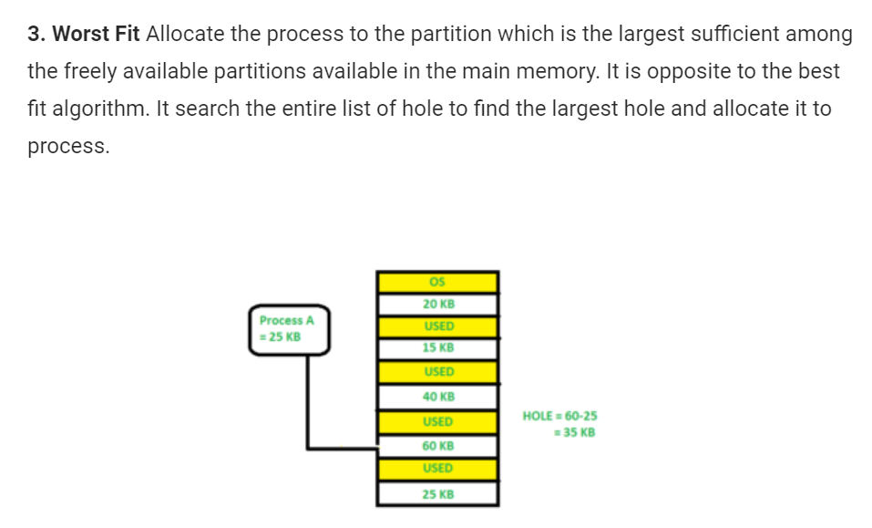

Slide 33
MULTIPLE-PARTITION ALLOCATION
FIXED PARTITION ALLOCATION
One memory allocation method is to divide the memory into a number of fixed-size partitions.
Each partition may contain exactly one process. Thus the degree of multiprogramming is bound by the number of partitions.
When a partition is free, a process is selected from the input queue and is loaded into the free partition.
When the process terminates, the partition becomes available for another process.

Slide 34
FRAGMENTATION
What is Fragmentation?
Processes are stored and removed from memory, which creates free memory space, which are too small to use by other processes.
After sometimes, that processes not able to allocate to memory blocks because its small size and memory blocks always remain unused is called fragmentation.
This type of problem happens during a dynamic memory allocation system when free blocks are quite small, so it is not able to fulfill any request.

Slide 35
TWO TYPES OF FRAGMENTATION
External fragmentation
External fragmentation can be reduced by rearranging memory contents to place all free memory together in a single block.
Internal fragmentation
The internal fragmentation can be reduced by assigning the smallest partition, which is still good enough to carry the entire process.

Slide 36
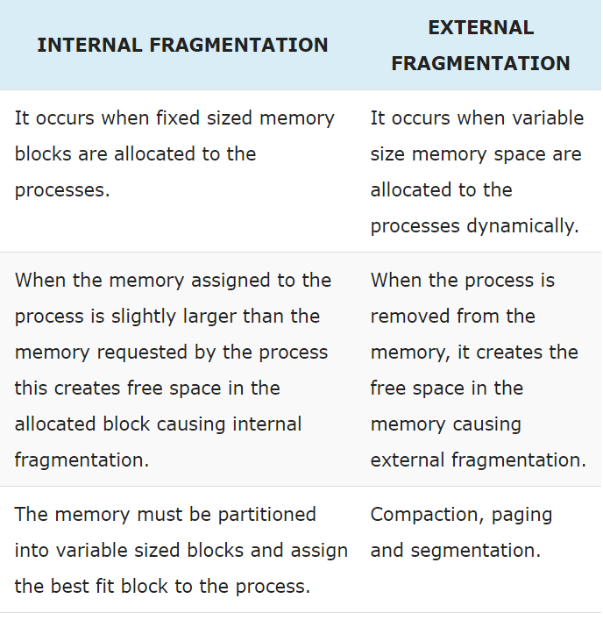

Slide 37
PAGING
A solution to fragmentation problem is Paging.
Paging is a memory management mechanism that allows the physical address space of a process to be non-contagious.
Here physical memory is divided into blocks of equal size called Pages.
The pages belonging to a certain process are loaded into available memory frames.

Slide 38
PAGING
Logical Address or Virtual Address (represented in bits): An address generated by the CPU
Logical Address Space or Virtual Address Space( represented in words or bytes): The set of all logical addresses generated by a program
Physical Address (represented in bits): An address actually available on memory unit
Physical Address Space (represented in words or bytes): The set of all physical addresses corresponding to the logical addresses
Physical memory is broken into fixed-size blocks called FRAMES.
Logical memory is also broken into blocks of the same size called PAGES.

Slide 39
PAGE TABLE
A Page Table is the data structure used by a virtual memory system in a computer operating system to store the mapping between virtual address and physical addresses.
Virtual address is also known as Logical address and is generated by the CPU. While Physical address is the address that actually exists on memory.

Slide 40
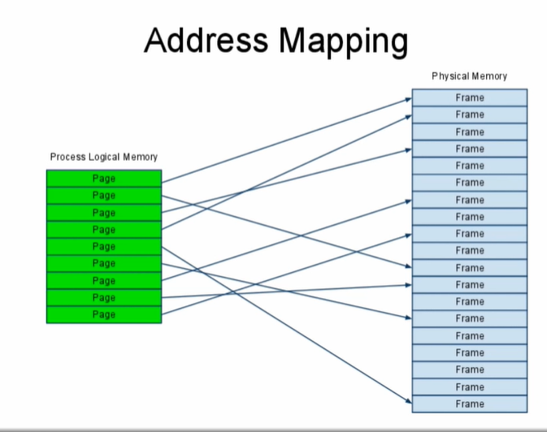

Slide 41
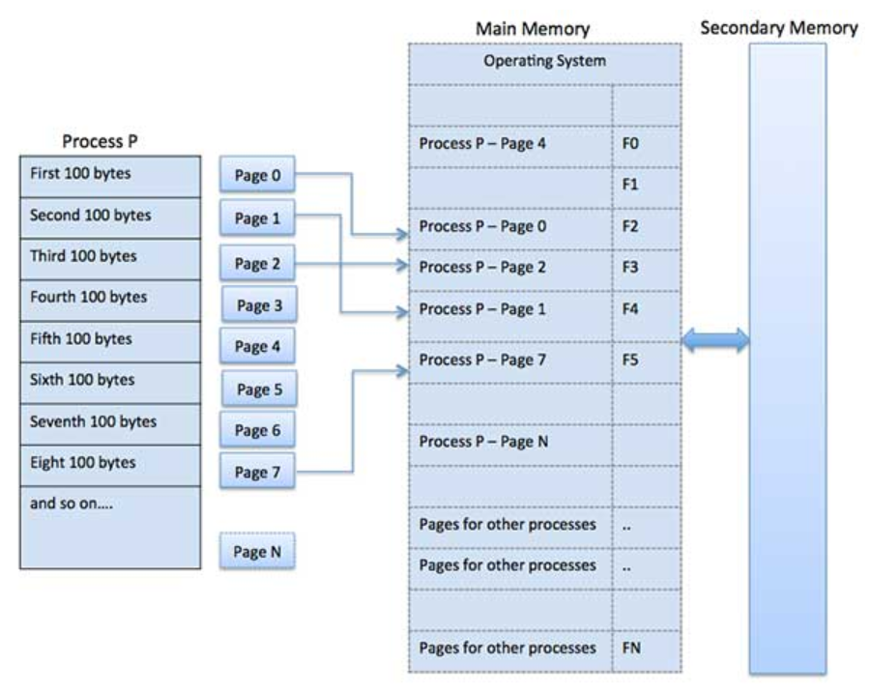

Slide 42
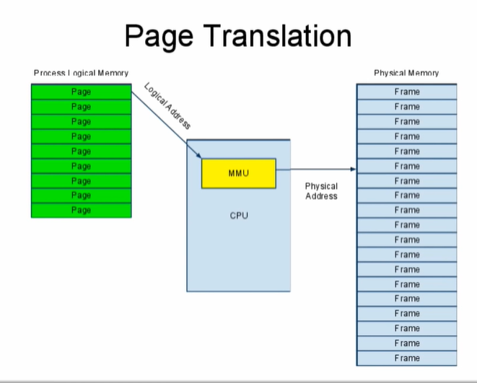
https://www.youtube.com/watch?v=-Ypa8Uwf5YA

Slide 43
Address Translation
Page address is called logical address and represented by page number and the offset.
Logical Address = Page number + page offset
Frame address is called physical address and represented by a frame number and the offset.
Physical Address = Frame number + page offset
Paging eliminates external fragmentation altogether but there may be a little internal fragmentation.

Slide 44
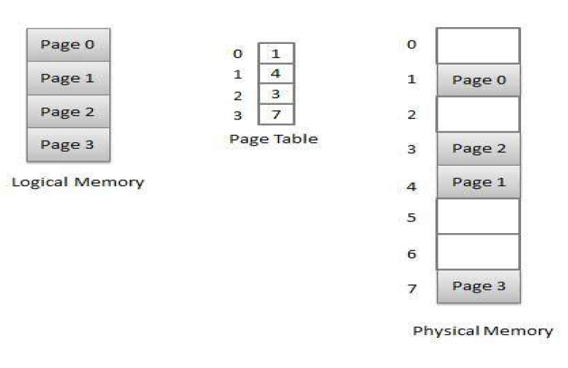
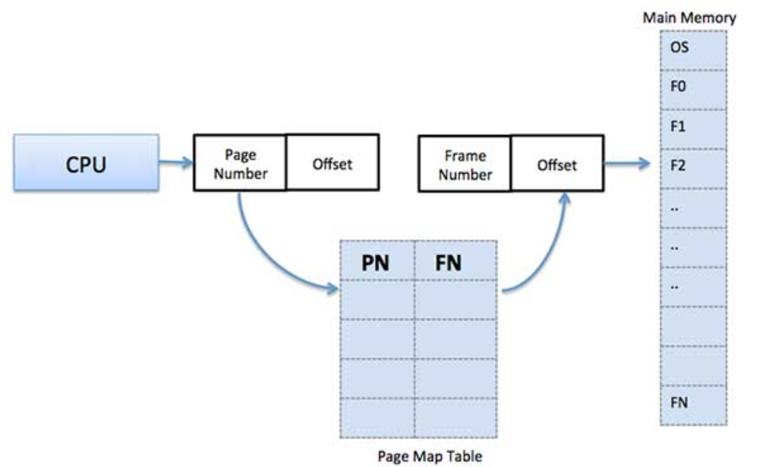

Slide 45
SEGMENTATION
Segmentation is a memory management technique in which each job is divided into several segments of different sizes, one for each module that contains pieces that perform related functions.
Each segment is actually a different logical address space of the program.
Segmentation memory management works very similar to paging but here segments are of variable-length where as in paging pages are of fixed size.
https://www.youtube.com/watch?v=p9yZNLeOj4s
https://www.youtube.com/watch?v=Gjfiuj3lm2o

Slide 46
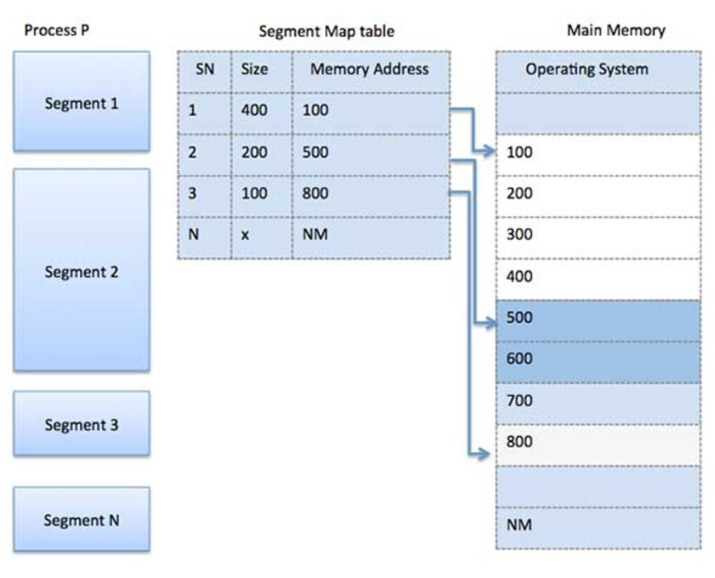

Slide 47
TUPLES
In the context of relational databases, a tuple is one record (one row).
The information in a database can be thought of as a spreadsheet, with columns (known as fields or attributes) representing different categories of information, and tuples (rows) representing all the information from each field associated with a single record.

Slide 48
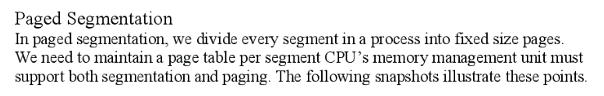
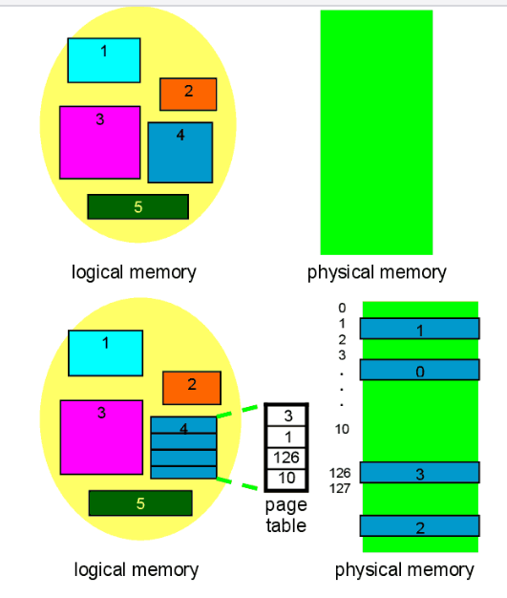
PAGED-SEGMENTATION

Slide 49
PAGE REPLACEMENT
In a operating systems that use paging for memory management, page replacement algorithm are needed to decide which page needed to be replaced when new page comes in.
Whenever a new page is referred and not present in memory, page fault occurs and Operating System replaces one of the existing pages with newly needed page.
Different page replacement algorithms suggest different ways to decide which page to replace.
The target for all algorithms is to reduce number of page faults.

Slide 50
PAGE FAULT
A page fault is a type of interrupt, raised by the hardware when a running program accesses a memory page that is mapped into the virtual address space, but not loaded in physical memory

Slide 51
PAGE REPLACEMENT ALGORITHMS
There are many page-replacement algorithms. We select a particular replacement algorithm based on the one with the lowest page-fault rate.
An algorithm is evaluated by running it on a particular string of memory references (called a reference string) and computing the number of page-faults.

Slide 52
TYPES OF REPLACEMENT ALGORITHMS
FIFO – First In First Out
LRU – Least Recently Used
Optimal Algorithm
LFU - Least Frequently Used
MFU - Least Frequently Used

Slide 53
VIRTUAL MEMORY
https://www.youtube.com/watch?v=qlH4-oHnBb8
https://www.youtube.com/watch?v=2quKyPnUShQ (All about Virtual Memory)
Virtual memory is a technique that allows the execution of processes that may not be completely in memory.

Slide 54
VIRTUAL MEMORY
Term refers to :
Something which is appears to be present ; But actually it is not present.
Something like Illusion
It allows the user to use more memory of the program than the real memory of the computer
A programmer can write a program which requires more memory than the capacity of main memory.
Such program is executed by virtual memory technique.

Slide 55
VIRTUAL MEMORY
Some important points related to Virtual memory
Only part of the program needs to be in the main memory for execution.
Logical address space can therefore be much larger than physical address space
Virtual memory allows address space to be shared by the several processes.
More programs can run concurrently.
Less I/O needed to load or swapping the process.

Slide 56
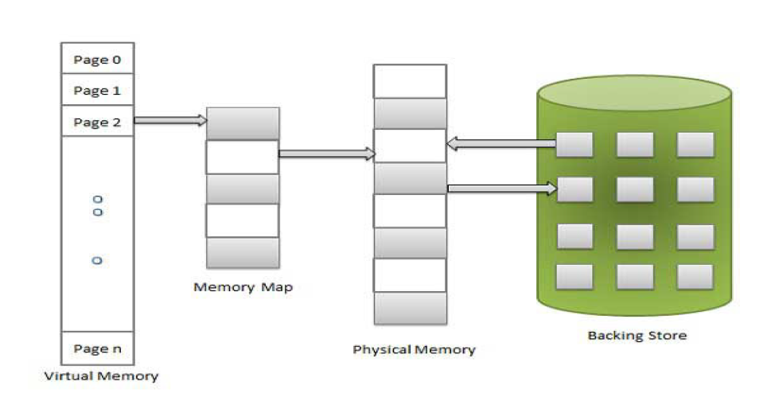
VIRTUAL MEMORY

Slide 57
DEMAND PAGING
A demand-paging system is similar to a paging system with swapping.
When a process is to be swapped in, the pager guesses which pages will be used before the process is swapped out again.
Instead of swapping in a whole process, the pager brings only those necessary pages into the memory.
Thus, it avoids reading into memory pages that will not be used anyway, decreasing the swap time and the amount of physical memory needed.

Slide 58
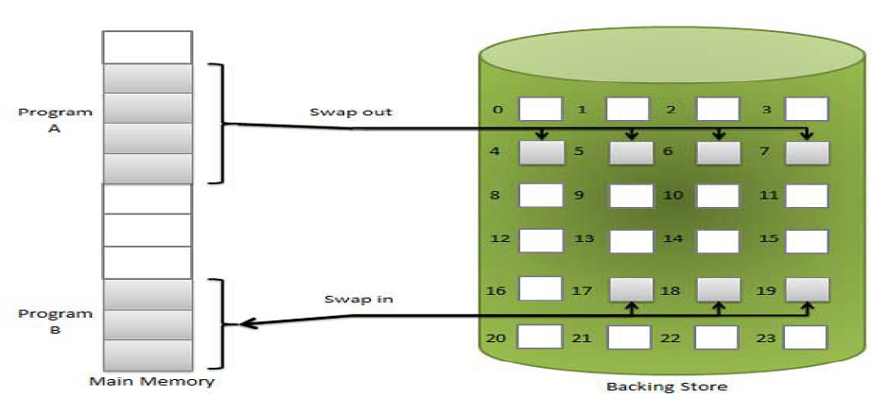
DEMAND PAGING

Slide 59
DEMAND PAGING
To distinguish between those pages that are in memory and those that are on disk, we use an invalid-valid bit which is a field in each page-table entry.
When this bit is set to “valid”, this value indicates that the associated page is both legal and in memory.
If the bit is set to “invalid”, it indicates that the page is either not valid (i.e., not in logical address space of the process), or is valid but is currently on the disk.
https://www.youtube.com/watch?v=dOVrEbZVeoU

